Slide 1
Business Process Management with ADONIS
Adapted after ADONIS Method Manual

Slide 2
Generalities
By using the ADONIS BPM toolkit, users can model their business processes as well as their working environment (organizational structures).
The toolkit offers extensive functionality, which allows to acquire, analyse, simulate and evaluate business processes and working environments in a cost-effective way.

Slide 3
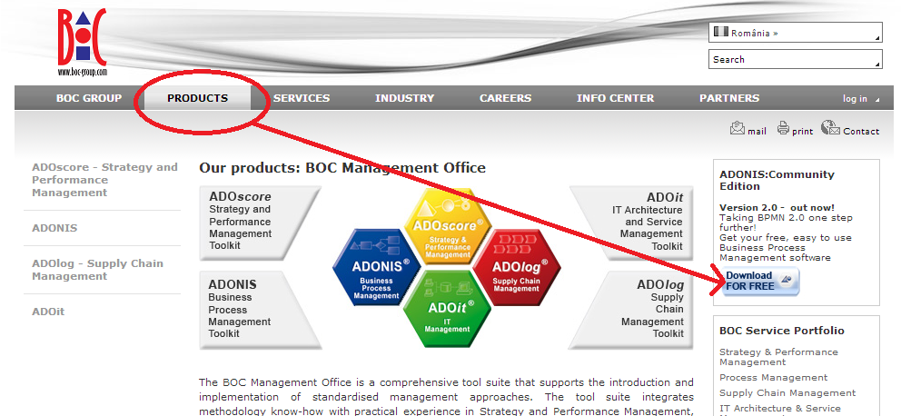
Installation Instructions
Step 1: http://www.boc-group.com/ro/products/

Slide 4
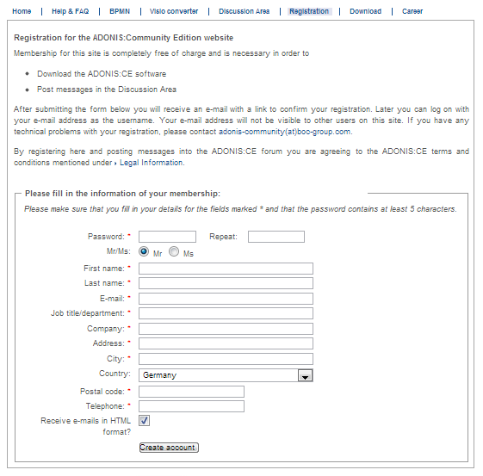
Step 2: Free registration on Adonis web site

Slide 5
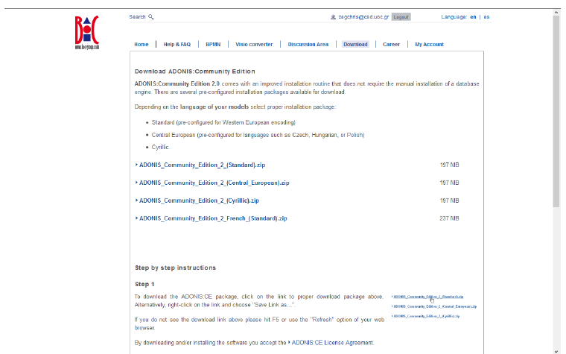
Step 3: Download Adonis Community Edition standard edition

Slide 6
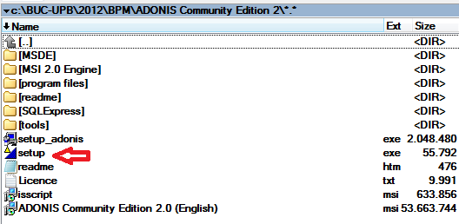
Step 4:
  Extract ADONIS_Community_Edition_2_(Standard).zip file
  Run setup.exe
The installation process will also install MS SQL Server 2008. Adonis Community Edition does not work with MS SQL Server 2012.

Slide 7
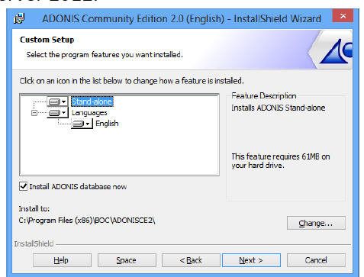
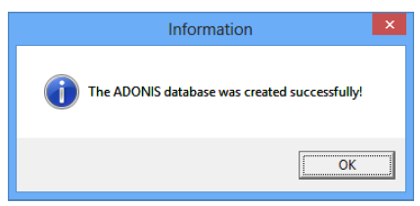
If correct….

Slide 8
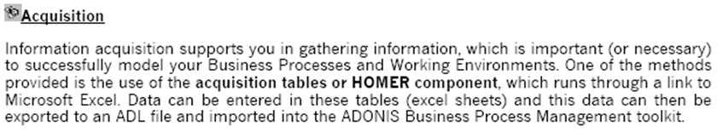
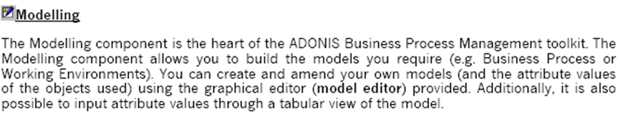
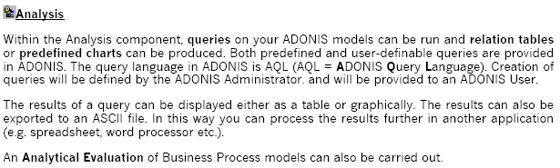
Components (1)

Slide 9
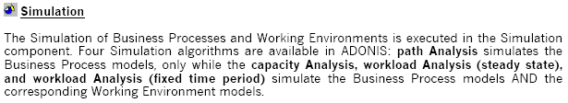
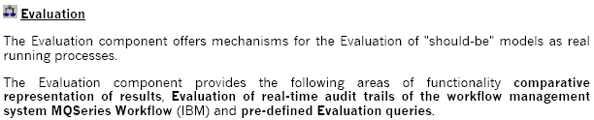
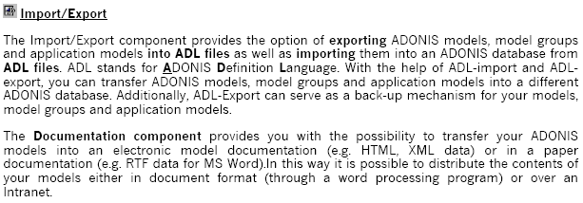
Components (2)

Slide 10
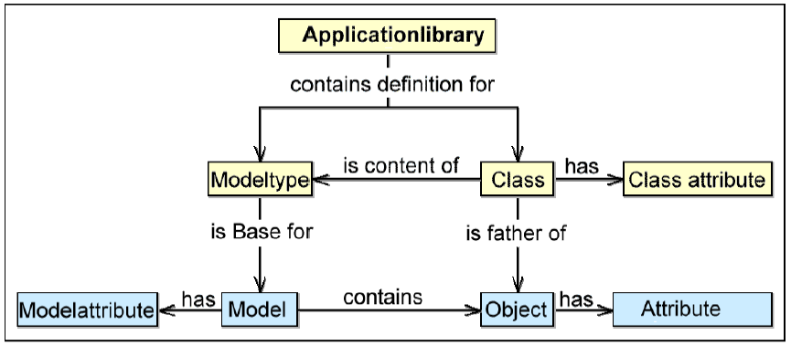
Terms and context in ADONIS
A model type is a grouping of classes, i.e., Company map, Business process model, Working environment model, Document model etc.
Classes represent the pattern for the objects created by users. Classes have class attributes, which control the graphical display of an object etc.
Models based on a model type will be created in the ADONIS BPM toolkit, having model attributes that provide general information about the model (e.g., date of creation, status)
A model is made up of objects, which are instances of classes. Objects have object attributes, which describe the model and its contents.

Slide 11
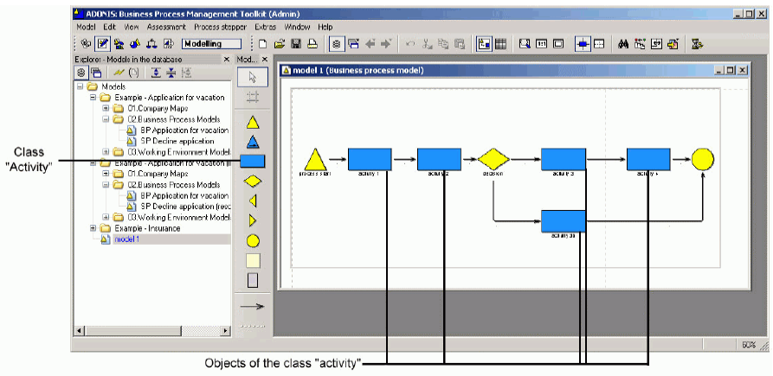
Example
Model, classes and objects in ADONIS: the figure shows the model “BP model 1” of the model type “Business Process Model”

Slide 12
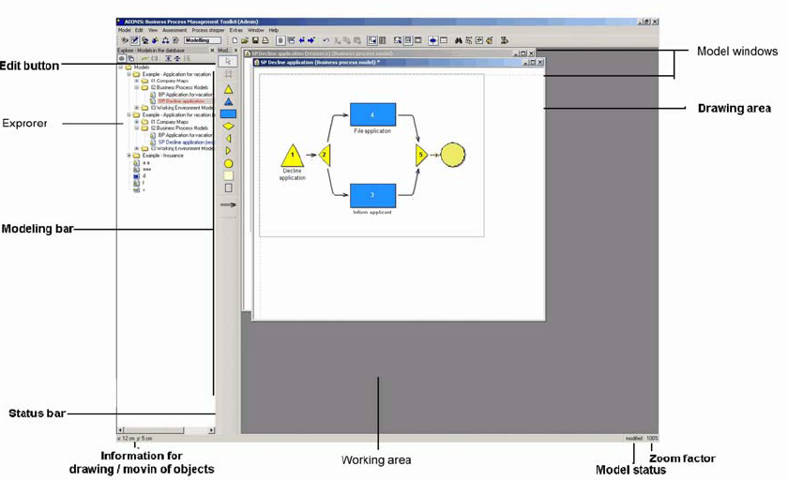
Modeling
The modeling of business processes and working environments plays a central role within ADONIS. Modeling is the basis for further work.

Slide 13
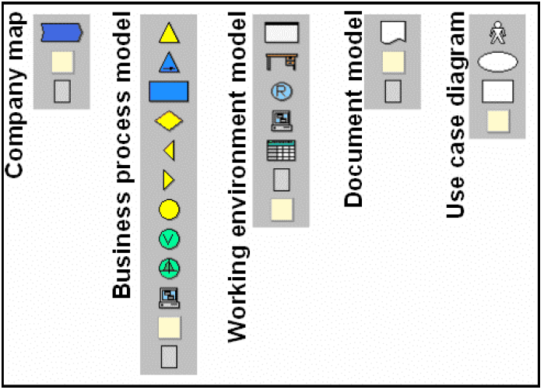
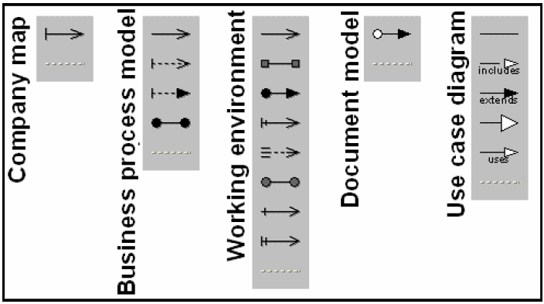
Modeling – Class Panel
The classes (left) and relations (right) available for modeling on the Class panel, depending on the model type.

Slide 14
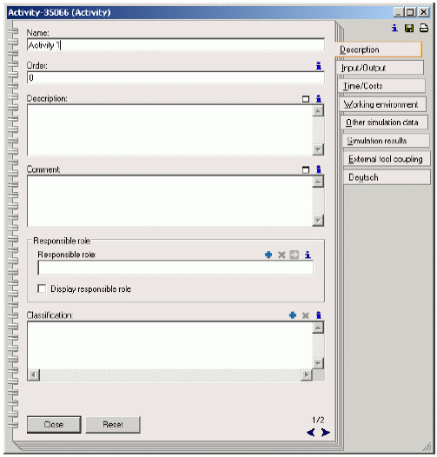
Modeling – Notebook
Double-clicking on an object or connector causes its ADONIS notebook to be opened.
Within an ADONIS notebook, you can edit the attributes of an object or of a connector.

Slide 15
Modeling – Practical Functionalities
Graphic generation: you can save models or model parts as graphic files (bmp, jpg, svg, png, pcx, emf).
Automatic Object Arrangement: You can select a predefined function to run on the current model to arrange objects and connectors automatically.
The drawing area will be automatically expanded, as soon as one object or connector is placed on the right or below the boarder of the drawing area.

Slide 16
Modeling – Transition Conditions (1)
Connectors leaving decision objects must be assigned with transition conditions or transition probabilities. These will be used by the simulation algorithms and Analytical Evaluation to determine under which conditions or probabilities a path will be chosen.
Transition conditions will be evaluated during the simulation, the valuation, the process cost analysis and the human resource planning. They consist of an expression, a probability or a macro and are assigned in the ADONIS notebook of the subsequent connector.
Transition probabilities will be raised during the Analytical Evaluation to determine paths.

Slide 17
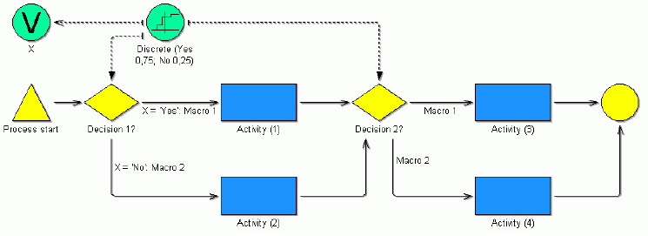
Modeling – Transition Conditions (2)
Example: macros of variables
“Macro1” replaces the transition condition “X=Yes” and “Macro2” the transition condition “X=No”.
Macros are globally valid.

Slide 18
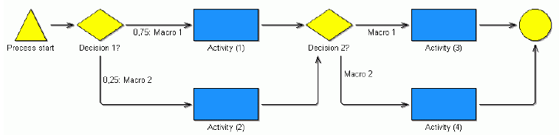
Modeling – Transition Conditions (3)
If macros for probabilities are defined, they will always be used after branching. This way, they show depending probabilities.
In this example, the probabilities will be evaluated after “Decision-1” for each process run. After “Decision-2”, the path which macros has been previously defined will always be taken. So there are only 2 possible paths through the process:
  Process start -> Decision-1 -> Activity (1) -> Decision-2 -> Activity (3) -> End
  Process start -> Decision-1 -> Activity (2) -> Decision-2 -> Activity (4) -> End

Slide 19
Modeling – Assigning and Defining Sub Processes
Sub processes enable you to keep your business process models clearly structured or to reuse models.
ADONIS supports the following proceeding to model process models through the assignment and definition of sub processes in reference sub processes:
  Bottom-up Modeling: you start the model by modeling the sub processes (lowest level, while modeling the higher processes later on.
  Top-down Modeling: you begin modeling at the highest level (the main process).

Slide 20
Modeling – Assigning Performers
Business process models and working environment models are linked on the one hand by defining application models and on the other hand by assigning performers to activities.
Such links enable the capacity and workload simulations, as well as Process Cost Analysis.
Assigning performers means that one or a group of performers are entered into the attribute “Performer” of each object of the class “Activity”. These performers can execute the particular activity within the simulation.
In order to define the performers who can execute a particular activity, you must first select the working environment model, in which the performers to be assigned, their roles and their organizational units have been modeled.
You can also define assignments with probabilities. For instance, an activity should be assigned with a probability of 20% to a performer of the role “Clerk”, with 30% to a performer of the role “Secretary” and with 50% to a performer of the role “Temporary help”.

Slide 21
Modeling – Assigning Resources
Allocating resources means that one or more actual resources are assigned to each object of the class “Resource” via the “Selection” attribute. These recourses are required when executing an activity.
Allocated resources are evaluated in the simulation component during capacity analysis and workload analysis.
Before resources can be allocated, you must first select the working environment model in which the resources to be allocated are modeled.
Exactly one resource is allocated to an activity.

Slide 22
Modeling – Performer and Process Calendar
The performer calendar allows you to define working time profiles for objects of class “Performer”. This calendar is evaluated by the workload analysis and specifies, for a one year period, the presence of a performer.
  The default setting is that Monday to Friday are working days, Saturday and Sundays are days off (vacation are not taken into account).
The process calendar offers you the possibility to define occurrence profiles for every business process. The calendar is evaluated by the simulation algorithm workload analysis and states the period of occurrence and the probability of occurrence of a given business process referring to one year.
  Example: if you enter the frequency “Uniform (00:30:00; 02:00:00)”, the business processes will be triggered from every 30 minutes (min) to every two hours (max).

Slide 23
Modeling – Modeling Guidelines
Completeness
  Each model must have exactly one start object and at least one end object that must be completely and logically linked by other modeling objects and/or connectors (e.g., activities, decisions etc)
  The transition conditions or probabilities after a decision must be defined correctly.
  A performer assignment must be defined in every activity.
  An application model of at least one business process model and exactly one working environment model must be defined.
Modeling and nesting parallel paths
Performer assignment and resource allocation
Performer and process calendar
Sub processes

Slide 24
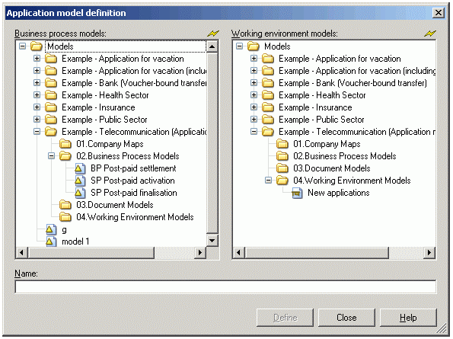
Modeling – Application Models
Defining application models is necessary if you wish to execute the Simulation algorithms “Capacity Analysis” and “Workload Analysis” in the Simulation component. An application model combines exactly one working environment model with one or more business process models.
To define an application model, select the “Application models…” from the “Model” menu and click in the “application models” window on the “Add” Button. The Application Model definition window will be displayed.

Slide 25
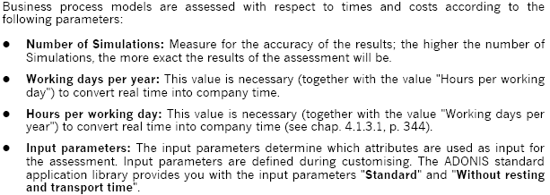
Modeling – Calculating times and costs
The assessment of business process models enables you to calculate average values for the following criteria:
  Execution time
  Waiting time
  Resting time

Slide 26
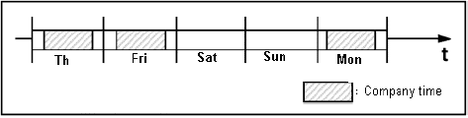
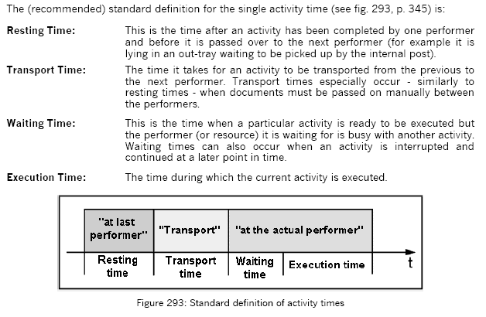
Modeling – Time concepts
Company time and Real time: Company time means the time during which your business process models are executed.
Activity times (attributes of activities):
  Execution time
  Resting time
  Transport time
  Waiting time

Slide 27
Analysis
The Analysis component allows you to carry out static evaluation on your ADONIS models (the Simulation component allows the possibility of dynamic evaluation).
In “Queries/Reports” you can analyze the contents of your models (objects, connectors, their attributes), which contain specific defined criteria. The results can be displayed either in graphical or tabular form and saved in different formats.
Additionally, it is possible to execute “predefined queries”.
When carrying out a standardized query, you only need to supply the missing parameters, without having to enter an AQL expression. A user-defined query is carried out by combining standardized queries or using AQL expressions, which can be formulated directly.
You may also execute certain predefined queries or generate predefined plans.

Slide 28
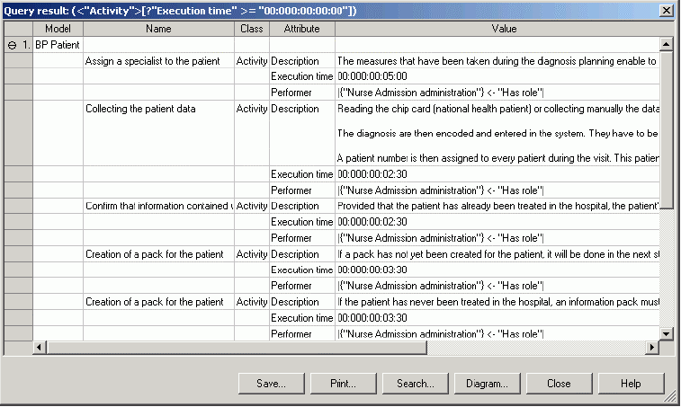
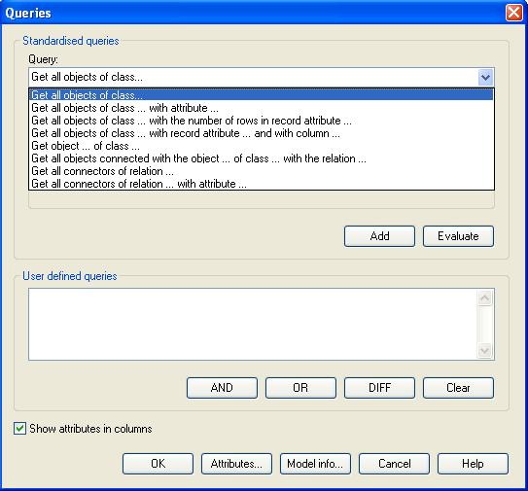
Analysis – Carrying out Queries

Slide 29
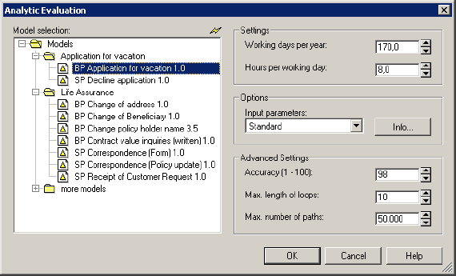
Analysis – Analytic Evaluation
Analytic Evaluation enables you to carry out a static evaluation of your business process models. The working environment is not taken into account.
Analytic Evaluation calculates the average times and costs of the business processes in question. In particular the analytic evaluation provides the following results:
  Frequency
  Execution time
  Waiting time
  Resting time
  Transport time
  Costs
  Execution time (working days)
  Cycle time

Slide 30
Simulation
By simulating your Business Process Models you can try out potential restructuring measures and examine the effects of such measures from different views.
ADONIS provides you with the following simulation algorithms:
  Path analysis
  Capacity analysis
  Workload analysis (steady state) (with animation)
  Workload analysis (fixed time period) (with animation)
In addition, there are evaluation mechanisms that enable you to carry out further evaluation on the simulation results by using ADL queries (i.e., determine all processes which have an aggregated execution time of more than 50 days per year). Evaluation queries are carried out in an identical manner for all simulation algorithms.

Slide 31
Simulation – Overview of the simulation algorithms
Path analysis allows you to evaluate your Business Process Models without taking the Working Environment into account, whereas in capacity analysis and workload analysis there are assignments of performers to the activities.
Capacity analysis vs Workload analysis
  Capacity analysis determines how many resources (performers and machines) are necessary for the execution of certain business process models based on how often these models are executed in a given period of time.
  Workload analysis determines the waiting and cycle times of business process models and activities based on a given quantity of resources and their availability
Steady state vs fixed time period workload analysis
  Steady state: a specific number of process runs are simulated, independent of the time period covered by the execution of the models. The results are calculated once a steady state has been reached.
  Fixed time period: a previously determined time period is simulated, independent of how many models are executed within this period.

Slide 32
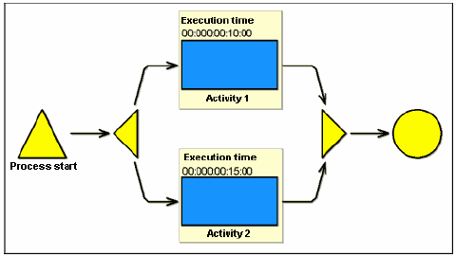
Simulation – Parallelisms
One of the most important results which ADONIS produces is the average cycle time of a business process, which specifies how much time is needed on average from the start of a business process to its end.
The execution time of business process model shown below is 25 minutes, while the cycle time is 15 minutes, since both activities are executed in parallel and so can start at the same time.

Slide 33
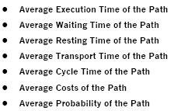
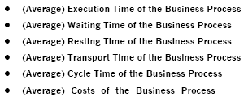
Simulation – Path analysis
The path analysis algorithm enables you to evaluate your business process models without regard to the working environment. You obtain process and path related results, which can be displayed both graphically and in text format.
Path results Business Process Results

Slide 34
Simulation – Capacity Analysis
Capacity analysis is based on an application model, consisting of exactly one working environment model and at least one business process model. It calculates business process costs.
A capacity analysis simulates each business process model contained in the application model as many times as specified in the number of simulations. The results can be examined either as process or period related. As the activities are assigned to performers, the capacity of each can be identified.
In addition, the personnel and resource costs of the activities and the business process models are calculated.
In order to run a capacity analysis, the performers of the various activities must be defined. Capacities with a value greater that 1 mean that the performer is overloaded.

Slide 35
Simulation – Workload Analysis
The workload analysis investigates the dynamic behavior of the organization. It bases calculations on the (process or performer) calendars and the waiting queues at simulation time.
The input is an application model. It calculates the waiting times of the activities and thus also cycle times of the processes using the workloads of the performers and resources. If an activity is assigned to a performer or to a resource, while he is still busy executing a different task, waiting time is caused.
The workload analysis simulates on the time axis, in contrast to the path and capacity analysis algorithms. Simulation on the time axis allows the number of activities a performer has to execute to vary as the processes are started at random.

Slide 36
Simulation – Agents
The task of agents is to support you if you wish to calculate additional non-standard simulation results. During the simulation the agents collect information about the behavior of the business process models and thus produce additional simulation results.
While the simulation calculates general process measures, such as cycle and execution times, you can employ agents to calculate process-specific measures, such as the cycle time up to a specific activity, the execution times of all manual activities etc.
Agent can also determine evaluation results for selected periods of time, for instance expected costs in the first quarter of a year.
There is a number of pre-defined agent types, based on templates that define their characteristics and tasks. Such agents are Animation/simulation progress, WE Agent:Personnel, BP Agent:Personel, BP Resource Agent, Standard.

Slide 37
Simulation – Offline Animation
Offline animation enables you to re-run a protocol created during a simulation.
It offers the following advantages:
  You can examine certain parts of the period simulated, fast forward or rewind the simulation protocol and replay the animation in single steps.
  Offline animation is usually faster than the simulation
  It is possible to investigate specific aspects of your models more closely. You may still define appropriate agents and repeat the previous simulation run exactly using the offline animation. The agents’ results are thus based on the same simulation events as the simulation results.

Slide 38
Evaluation
The Evaluation component offers a number of modules, such as:
  Comparison of results – you may compare the results of various ADONIS simulations or analysis to each other, that have previously been saved in the “Comparing Representation” format. There can be either tabular or graphical representation.
  Evaluation queries – various evaluation queries can be run either default or user-defined.
  Flowmark Audit Trail evaluation – this module enables you to evaluate processes and activities in a way similar to that of the simulation component, recognizing bottlenecks and other problem areas in a business process, which has been transformed into Flowmark (IBM) or MQSeries Workflow (the most recent version of Flowmark).

Slide 39
Import/Export
The Import/Export component enables you to export to ADL or XML files the models, model groups, attribute profiles and application models that are saved in the ADONIS database.
Using the documentation component, you can transform ADONIS models to files (e.g., HTML, RTF, XML). This way it is possible to integrate the model contents including graphical representation into documents.

Slide 40
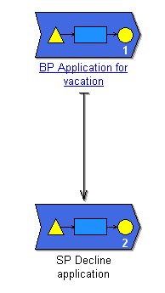
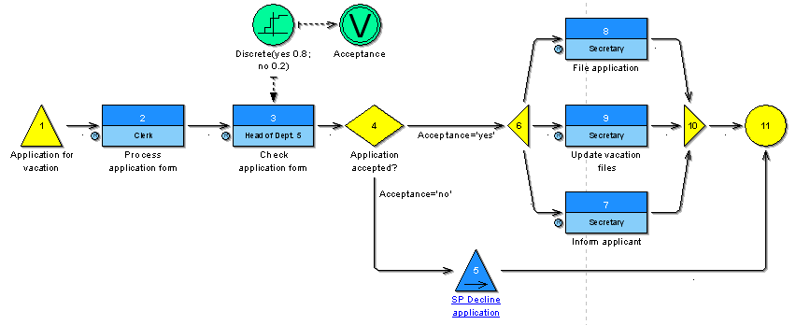
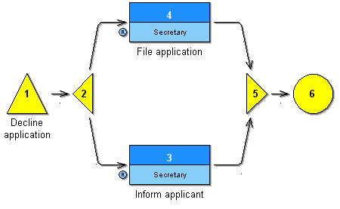
Examples – Application for Vacation
Company map
  Applying for vacation
Business Process Models
  BP Application for vacation
  SP Decline Application
Working Environment Models
  Application Department

Slide 41
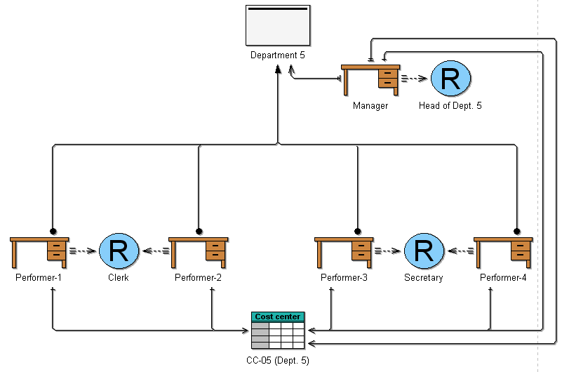
Examples – Application for Vacation
Working Environment: Application Department

Slide 42
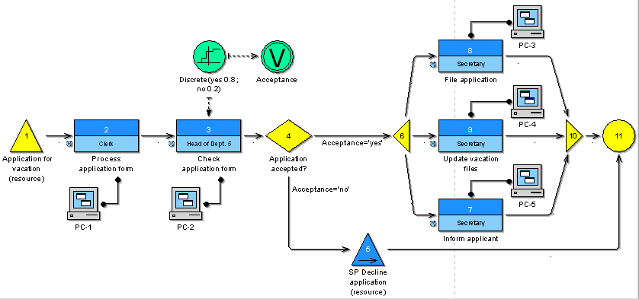
Examples – Application for Vacation (with resources)
BP Application for vacation Process Model

Slide 43
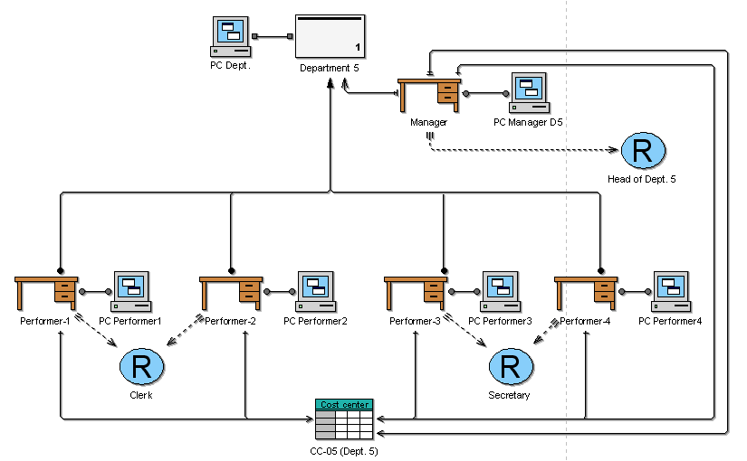
Examples – Application for Vacation (with resources)
Application Department Working Environment Model

Slide 44
Useful resources
http://www.bpm-guide.de/wp-content/uploads/2012/06/adonis/adonis.html
http://mariaiulianadascalu.files.wordpress.com/2012/03/adonis_method_manual.pdf
http://mariaiulianadascalu.files.wordpress.com/2012/03/adonis_user_manual.pdf

Slide 45
Project (1)
in teams of 2-4 people (a team of 2 has to have at least 2 sub-processes; a team of 3 has to have at leas 3 sub-processes; a team of 4 has to have at least 4 sub-processes)
description of process scenario (e.g.: license issuing procedure)
“as-is” business process model:
  Design in ADONIS the complete business process that is described in the scenario; in your process all the appropriate model types must be included: Company map, business processes and sub-processes, working, correctly connected and customized (times, costs etc); it is not necessary to use all the available classes; only those that are necessary.

Slide 46
Project (2)
evaluation:
  consistency check:
    At the Analysis component, execute Consistency checks on Business Process Models.
  analytical evaluation
    Execute analytical evaluation (Analysis component) in the main business process using initially one execution and then the process execution frequency you have declared. Comment on the results (for example, if you detect any problem.)
  simulation
    Execute Path Analysis in your model and comment on the time of each branch. Then, execute Capacity Analysis for your model, select “Person related” simulation results and interpret each performer’s capacity value in comparison to the personnel cost. (Which are the system requirements, which performers mostly overload the system and why etc.).
“to-be” business process model
  Locate the points at which your model malfunctions/points for improvement and justify them with the corresponding query results and the measurements you have until now. Propose an alternative model, where the operations are executed in parallel or automated or with different order. Present how these changes can influence the model’s execution time and the characters’ workloads. This “to-be” process model has to be described in words/drawings, not in ADONIS. Of course, if you want, you can make it in ADONIS, too.

Slide 47
Project Deliverables (3)
the adl files of your model
a report (in editable format) – no more than 6 pages if you work in teams of 2, no more than 8 pages if you work in teams of 3, no more than 10 pages if you work in teams of 4 :
  the authors’ names
  the process scenario
  a short description of your model’s workflows, the choices you have taken, the involved roles, the values of your parameters, some images of your sub-process and any other information you consider necessary to understand the model
Obs.: use TNR of 11 as a font, line spacing 1.5

Slide 48
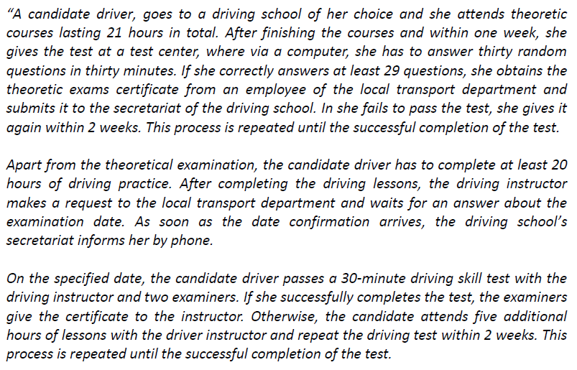
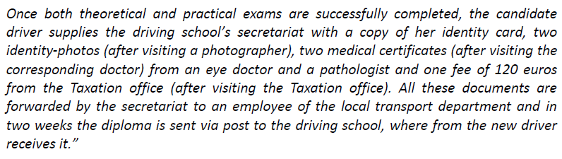
Scenario for license issuing procedure

