Slide 1



Doctoral Schools at UPB
Assoc. prof. Maria-Iuliana Dascalu, PhD
Assoc. prof. Elisabeth Lazarou
University POLITEHNICA of Bucharest, Faculty of Engineering in Foreign Languages
maria.dascalu@upb.ro, elisabeth.lazarou@upb.ro
EXTEND Seminar, 10th of March– 17th of March 2019, RTU, Riga, Latvia

Slide 2
Overview
Duration: 3 (+ 2) years
Components (30 credit points * 6 semesters):
  Graduate study program based on advanced university studies: 1 semester
  The individual scientific research program: 5 semesters
2 fundamental domains:
  engineering sciences – 11 domains (electrical engineering, energy engineering, systems engineering, computers and information technology, electronics and telecommunications, mechanical engineering, industrial engineering, transport engineering, aerospace engineering, materials engineering, chemistry engineering)
  exact sciences – 3 domains (chemistry, physics, mathematics)
In the present, 14 PhD Schools, led by THE COUNCIL OF DOCTORAL UNIVERSITY STUDIES (CSUD):
  2012: 13 PhD schools grouped based on the domains, within faculties (several domains in the same PhD school, which is subordinated to a faculty)
  2013: Doctoral School of Laser and Accelerator Engineering and Applications
218 research laboratories

Slide 3
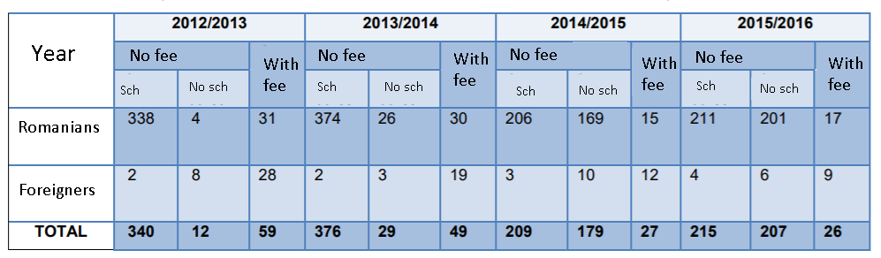
Statistics

Slide 4
More statistics
Most attractive PhD schools: Applied Chemistry and Materials Science, Engineering and Management of Technological Systems, Automation and Computers, Electronics and Telecommunications
More men than female (2/3 men, 1/3 women)
Number of PhD advisors: ~350
Number of defended PhD thesis: > 1150
4 qualifiers: 7% -13% are finished with Excellent, most are finished with Very Good, very few with Good, none with Satisfcatory
Number of thesis in co-tutela: more than 35

Slide 5
Useful information (in English)
Faculty of Engineering in Foreign Languages has 2 PhD advisors in the Doctoral School of Automatic Control and Computers
Doctoral School of Automatic Control and Computers: http://doctorat.acs.pub.ro/en/admission-doctorate/admission-2018-2019/
METHODOLOGY for the admission of Ph.D. students from non-EU countries in “System Engineering” and “Computers and IT” doctorate programs: http://doctorat.acs.pub.ro/wp-content/uploads/2017/01/SD_AC-methodoloy-for-Ph.D.-admission-of-non-EU-students.pdf

