Slide 1
Test: Translate the below text in RDF/XML and paint the corresponding RDF graph; then write the requested SPARQL queries.
Poe has written the poem "The Raven" translated by Mallarmé and the novel " The Gold Bug " translated by Baudelaire. Mallarmé has written a poem.
SPARQL1: Who translated “The Gold Bug”?
SPARQL2: Who were translators?

Slide 2
<?xml version="1.0" encoding="UTF-8"?>
<rdf:RDF xmlns:rdf="http://www.w3.org/1999/02/22-rdf-syntax-ns#" xmlns:f="http://example.org#" xmlns:rdfs="http://www.w3.org/2000/01/rdf-schema#" xmlns:xsd="http://www.w3.org/2000/01/rdf-schema#">
<rdf:Description rdf:ID="Poe">
<f:name>Poe</f:name>
<f:write rdf:resource="#Raven"/>
<f:write rdf:resource="#TheGoldBug"/>
</rdf:Description>
<rdf:Description rdf:ID="Raven">
<f:name>Raven</f:name>
<f:type>poem</f:type>
<f:translatedby rdf:resource="#Mallarme"/>
</rdf:Description>
<rdf:Description rdf:ID="TheGoldBug">
<f:name>TheGoldBug</f:name>
<f:type>novel</f:type>
<f:translatedby rdf:resource="#Baudelaire"/>
</rdf:Description>
<rdf:Description rdf:ID="Mallarme">
<f:name>Mallarme</f:name>
<f:write>
<rdf:Description>
<f:type>poem</f:type>
</rdf:Description>
</f:write>
</rdf:Description>
<rdf:Description rdf:ID="Baudelaire">
<f:name>Baudelaire</f:name>
</rdf:Description>
</rdf:RDF>

Slide 3
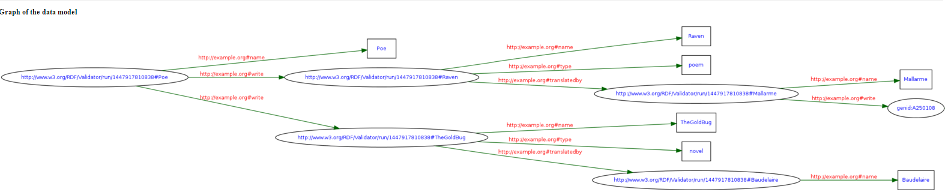


Use http://www.w3.org/RDF/Validator/ to obtain the below graph:
PREFIX f:<http://example.org#>
SELECT ?n
WHERE {
?x f:translatedby ?y.
?y f:name ?n.
?x f:name "TheGoldBug"
}
PREFIX f:<http://example.org#>
SELECT ?n
WHERE {
?x f:translatedby ?y.
?y f:name ?n
}

Slide 4
JENA RDF API

Slide 5
Useful resources
jena.apache.org/download/index.cgi (JENA code)
https://jena.apache.org/tutorials/rdf_api.html (JENA tutorial)
https://www.slideshare.net/rajighawi/java-and-sparql (SPARQL in Java)

Slide 6
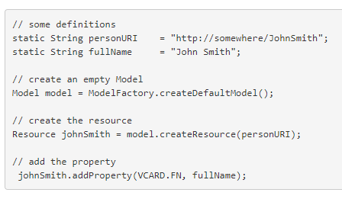
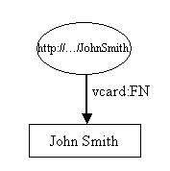
Creating a RDF graph/model in JENA

Slide 7
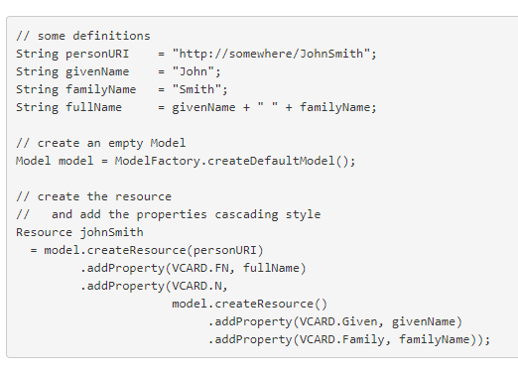
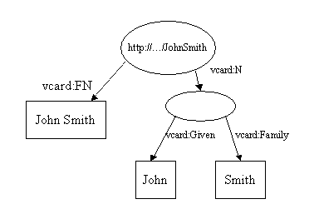

Slide 8
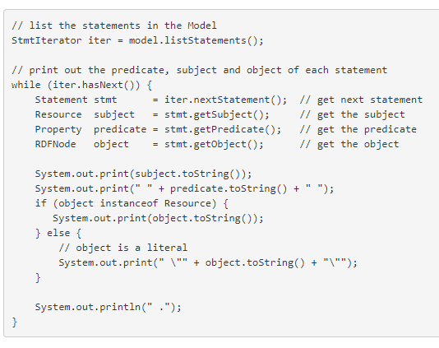
Listing all the triples(statements) in a graph

Slide 9

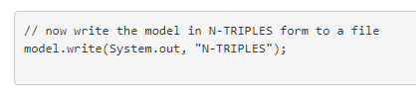
Writing RDF

Slide 10
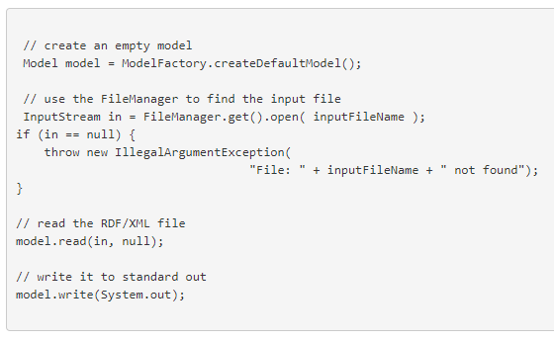
Reading RDF

Slide 11

Containers
bag, alt, seq

Slide 12
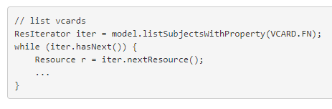


Querying a Model

Slide 13
Using SPARQL in Java
import com.hp.hpl.jena.rdf.model.*;
import com.hp.hpl.jena.query.*;
String uri = "http://example.org/";
Model model = ModelFactory.createDefaultModel(); //the JENA RDF model
Resource a = model.createResource(uri + “John");
Resource b = model.createResource(uri + "Mary");
Property hasFriend = model.createProperty(uri + “hasFriend");
a.addProperty(hasFriend, b);
String queryString =" PREFIX f:< http://example.org/> \n" + " SELECT DISTINCT ?x \n" + " WHERE {?x f:hasFriend ?y} \n";
Query query = QueryFactory.create(queryString) ;
QueryExecution qexec = QueryExecutionFactory.create(query, model);
ResultSet results = qexec.execSelect() ;

Slide 14
Triplestores
A triplestore or RDF store is a purpose-built database for the storage and retrieval of triples through SPARQL queries.
Some examples of triplestores are:
  AllegroGraph
  Stardog
  GraphDB™ by Ontotext
SPARQL 1.1 Update brings operations for updating, creating, and removing RDF graphs in a triplestore:
  https://www.w3.org/TR/sparql11-update/

Slide 15
Applications
Recommender systems - How social and semantic technologies can sustain employability through knowledge development and positive behavioral changes
https://www.sciencedirect.com/science/article/pii/S0747563217300250
Evaluation of open questions - Semantic Formative E-Assessment for Project Management Professionals
https://ieeexplore.ieee.org/abstract/document/7275219
Curriculum modelling and aligning - Ontologies-Facilitators for Curriculum Design in Centers of Excellence for Engineering Education
https://search.proquest.com/openview/a209c455a73c66a991b91465da1cb4f9/1?pq-origsite=gscholar&cbl=1876338

Slide 16
Models
https://www.dropbox.com/sh/2wy4epz1cgmtupw/AACKAR_NwKqc6eN8C_rdJJR1a?dl=0
https://mariaiulianadascalu.files.wordpress.com/2019/10/carteseweb_printech.pdf

